Slide 1

Aadil A A Ameena K A Aysha C R Haritha T H 245268 245255 245254 245205

Slide 2
What is Terraform?
Terraform is an open-source Infrastructure as Code (IaC) tool developed by HashiCorp.
It allows you to automate and manage your infrastructure, your platform and your services that run on that platform.
Terraform uses a declarative approach, allowing you to define infrastructure configurations as code.

Slide 3
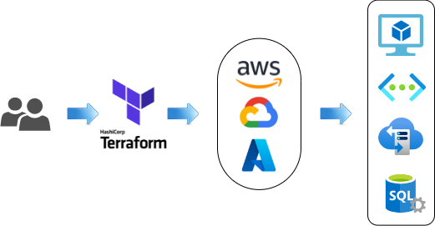
Key features and benefits of Terraform
Infrastructure as Code (IaC): Terraform treats infrastructure configurations as code, making it easy to manage, version, and collaborate on infrastructure changes.
Multi-Cloud Provisioning: Terraform supports multiple cloud providers, allowing you to provision resources on AWS, Azure, Google Cloud, and more using a single configuration.
State Management: Terraform keeps track of your infrastructure state, making it easy to update and manage resources over time.
Plan and Preview: Terraform provides a preview of changes before applying them, helping you understand the impact and avoid unintended modifications.
Scalability and Reusability: Terraform lets you create reusable infrastructure modules, enabling scalability and consistency across projects.

Slide 4
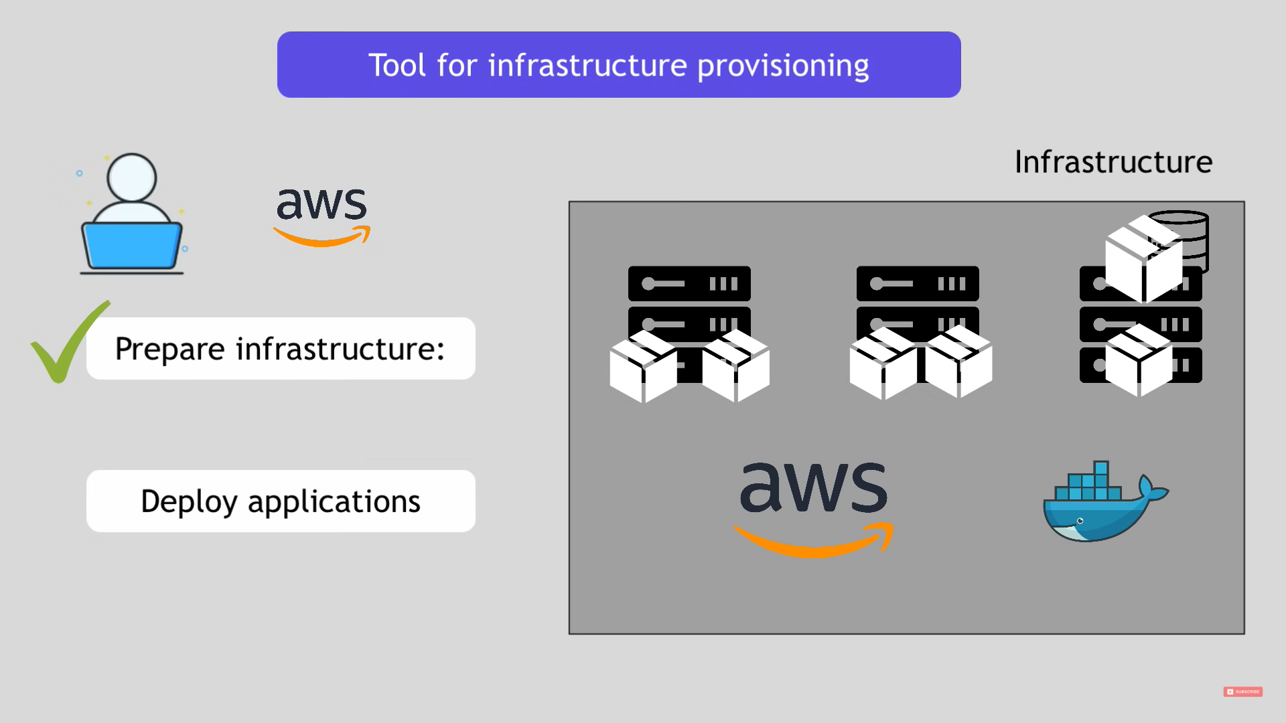

Slide 5
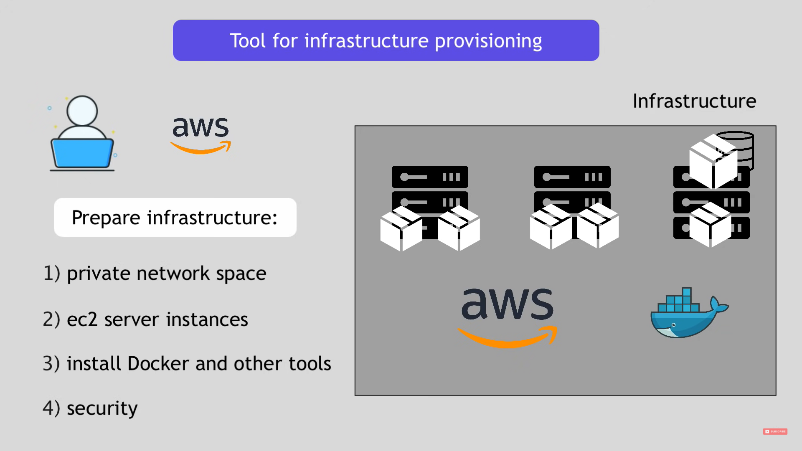

Slide 6
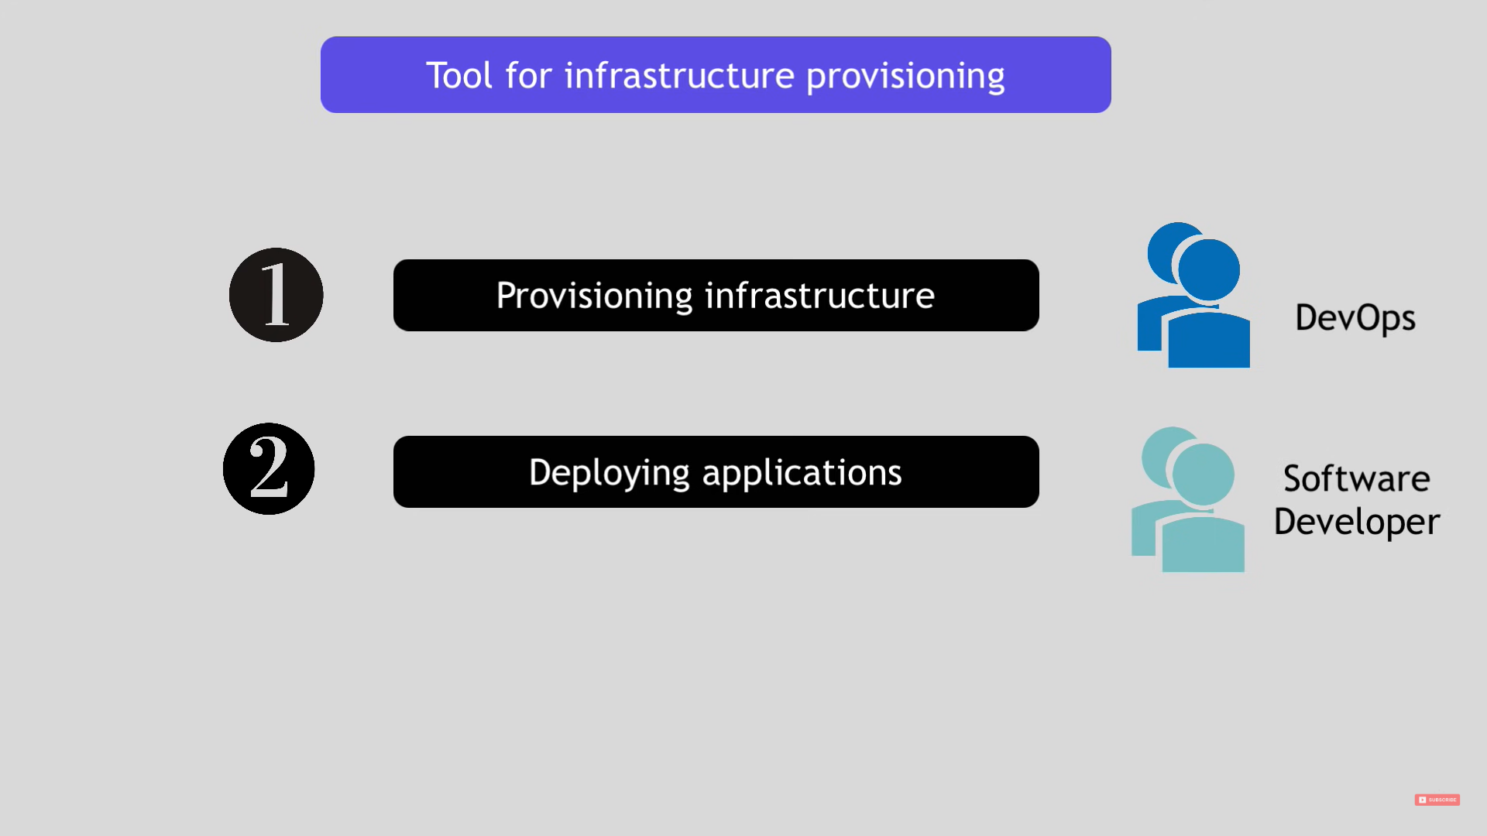

Slide 7
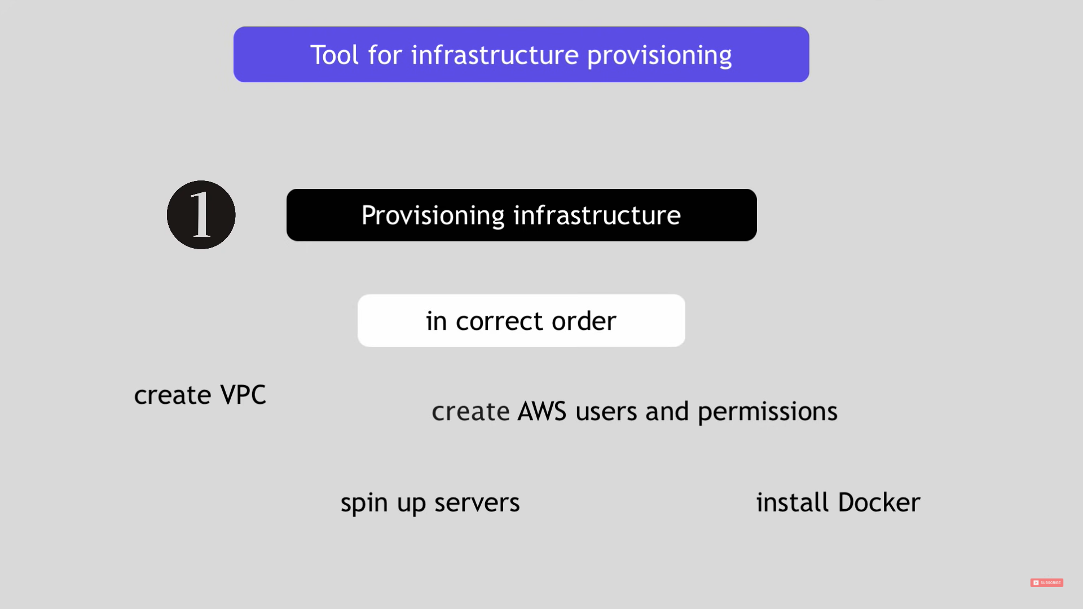

Slide 8
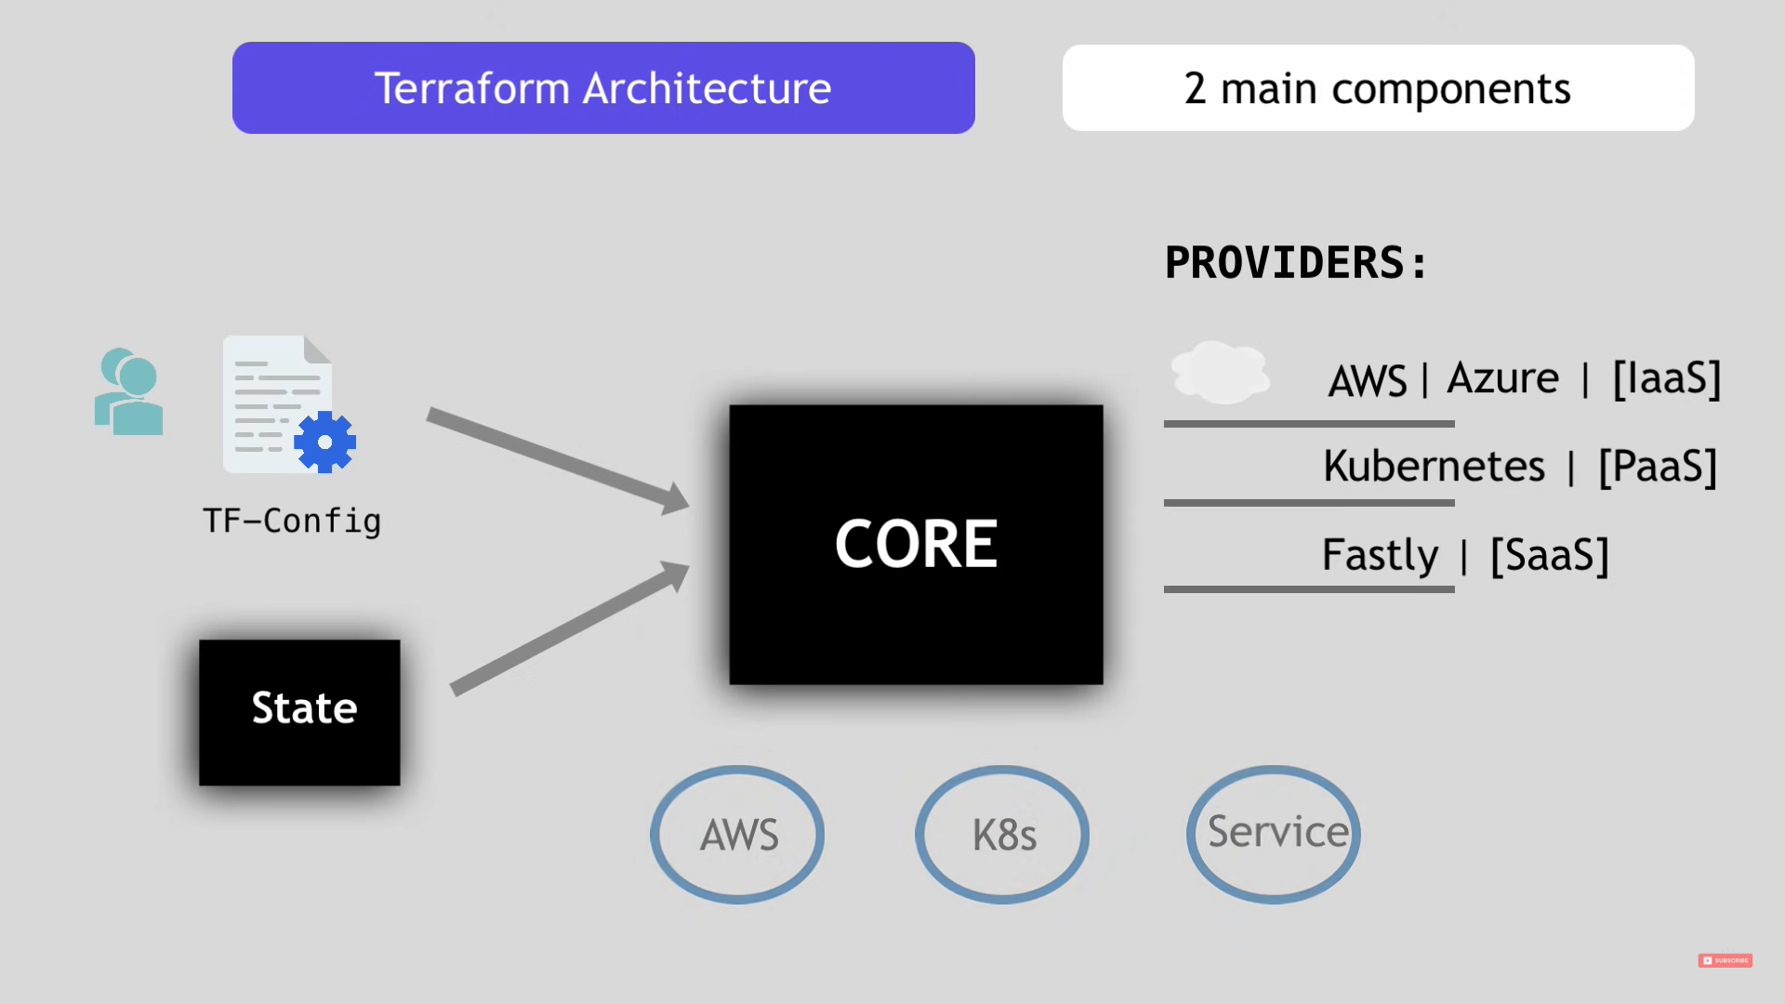
Terraform Architecture

Slide 9
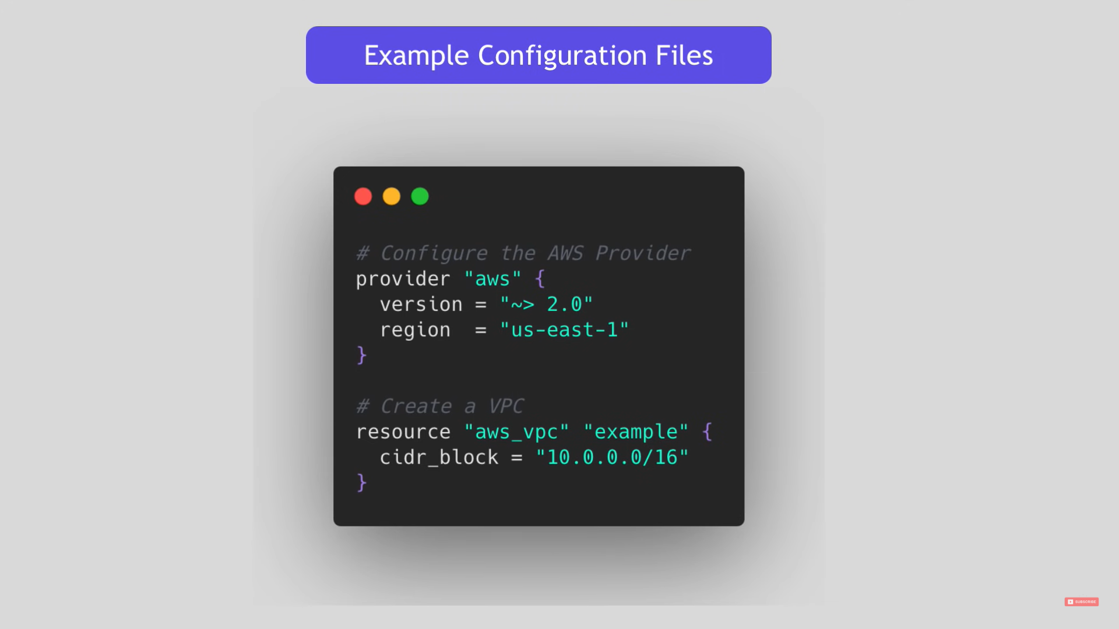
Example Configuration Files

Slide 10
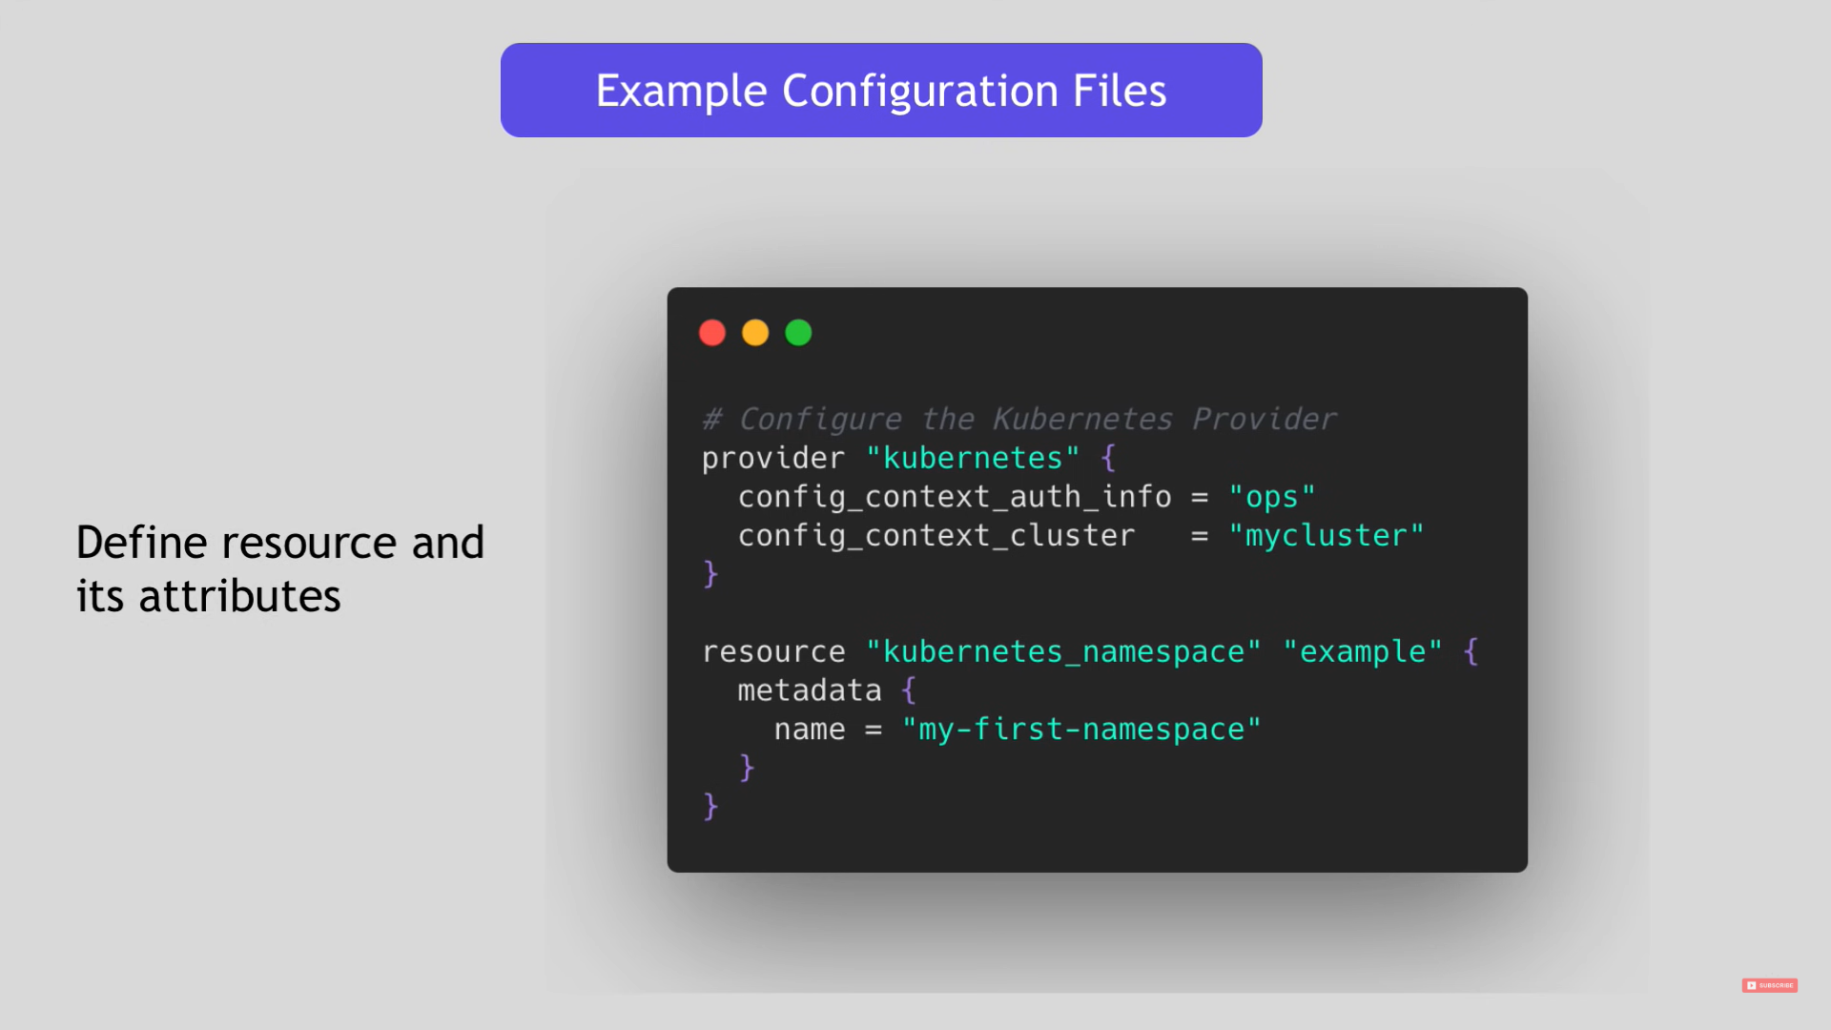

Slide 11
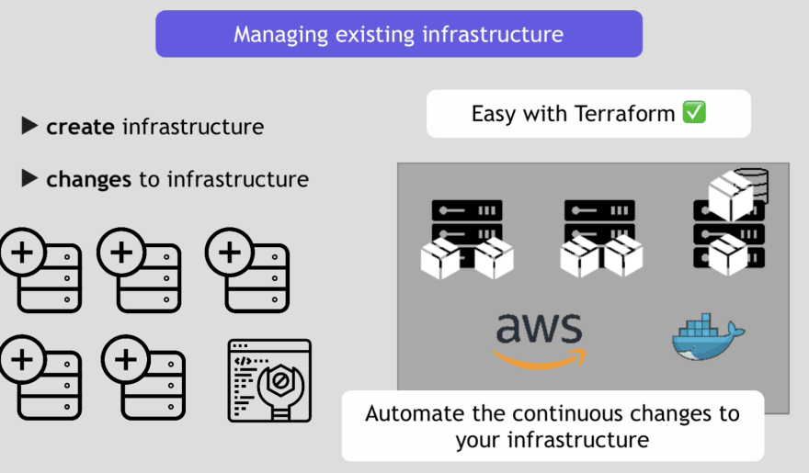

Slide 12
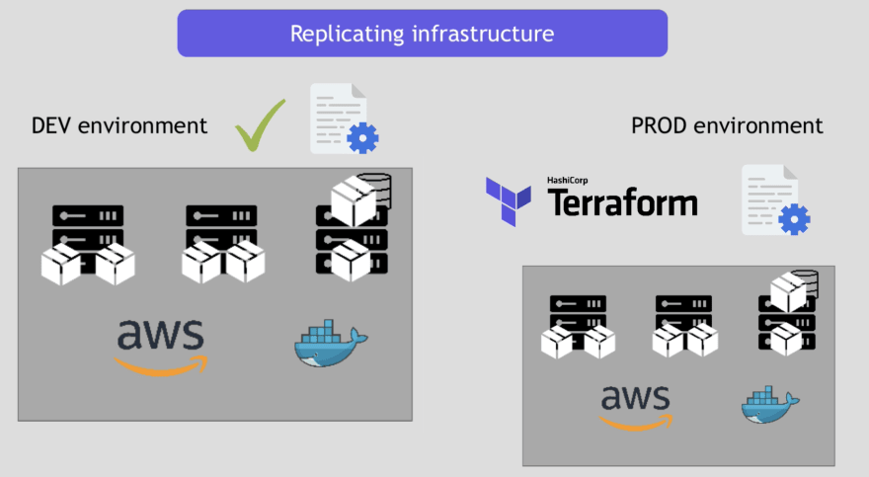

Slide 13
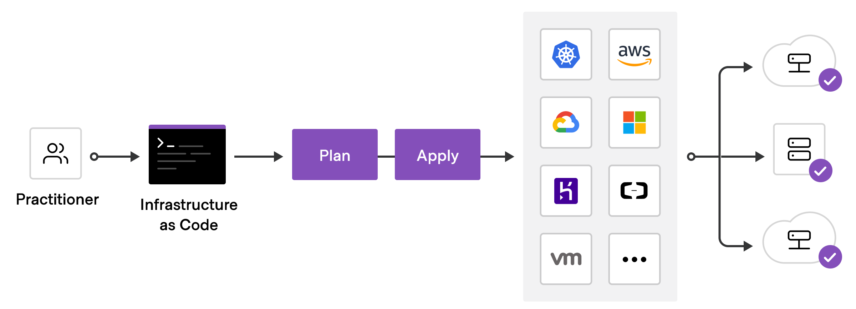
Workflow of Terraform
To deploy infrastructure with Terraform:
Scope - Identify the infrastructure for your project.
Author - Write the configuration for your infrastructure.
Initialize - Install the plugins Terraform needs to manage the infrastructure.
Plan - Preview the changes Terraform will make to match your configuration.
Apply - Make the planned changes.

Slide 14
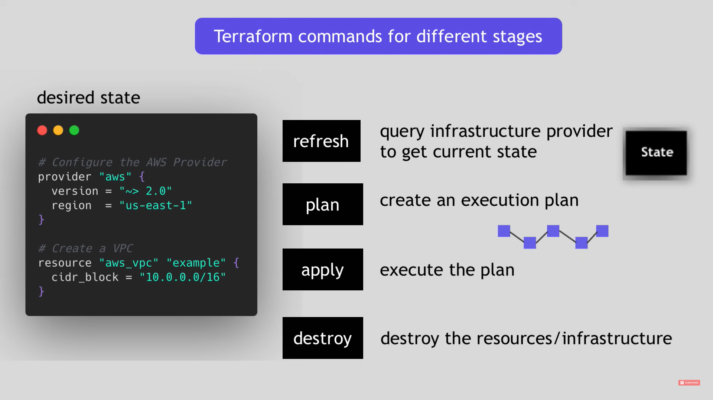

Slide 15
Steps to Follow
Install Terraform: Download and install Terraform from the official website
(https://www.terraform.io/downloads.html) based on your operating system.
Configure AWS Credentials: Set up your AWS credentials to allow Terraform to interact with your AWS account.
You can either set the environment variables AWS_ACCESS_KEY_ID and AWS_SECRET_ACCESS_KEY or use the AWS CLI command aws configure to configure your credentials.
Create a working directory: Create a new directory on your local machine to hold your Terraform files.

Slide 16
Initialize the working directory: Open a terminal or command prompt, navigate to the directory created in the previous step, and run the following command to initialize the working directory:
terraform init
Create a Terraform configuration file: Create a file named main.tf in your working directory and add the following code:
Initialize the Terraform configuration: Run the following command to initialize the Terraform configuration:
terraform init
Preview the changes: Run the following command to preview the changes Terraform will make to your AWS infrastructure:
terraform plan
Apply the changes: Run the following command to apply the Terraform configuration and create the AWS resources:
terraform apply

Slide 17
Continuous Integration and Continuous Delivery (CI/CD)

Slide 18
CI/CD
Continuous Integration (CI) is a practice where developers regularly merge their code changes into a central repository, after which automated tests are run to validate the merge. This practice helps to identify errors early in the development process, and to ensure that all developers are working on the same code base.
Continuous Delivery (CD) is a practice where software is automatically deployed to production environments, after each successful build and test. This practice helps to ensure that software is always available to users, and that new features and bug fixes can be deployed quickly and easily.

Slide 19
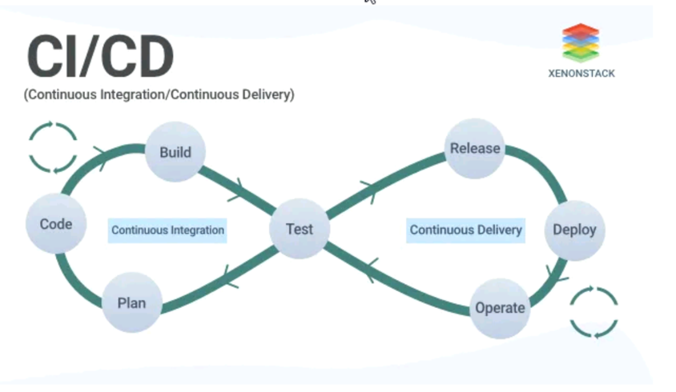

Slide 20
Continuous Integration and Continuous Delivery (CI/CD)
CI/CD stands for Continuous Integration and Continuous Delivery. It is a software development practice that aims to improve the quality and speed of software delivery by automating the process of building, testing, and deploying code.
CI/CD works by breaking down the software development process into smaller, more manageable steps. Each step is automated, which means that it can be repeated quickly and easily. This allows developers to catch errors early in the development process and to deploy code more frequently.

Slide 21
Advantages of using CI/CD
Improved quality: By automating the testing process, CI/CD can help to identify and fix errors early in the development process. This can lead to fewer bugs in the final product.
Increased speed: CI/CD can help to speed up the software development process by automating the build, test, and deploy steps. This can free up developers to focus on more creative and strategic tasks.
Increased reliability: CI/CD can help to improve the reliability of software by making it easier to deploy changes to production. This is because changes are tested and deployed in a controlled environment before they are released to users.

Slide 22
CI/CD pipeline
CI/CD Pipeline is a crucial part of the modern DevOps environment. The pipeline is a deployable path which the software follows on the way to its production with Continuous Integration and Continuous Delivery practices.
It is a development lifecycle for software and includes the CI/CD pipeline, which has various stages or phases through which the software passes.

Slide 23
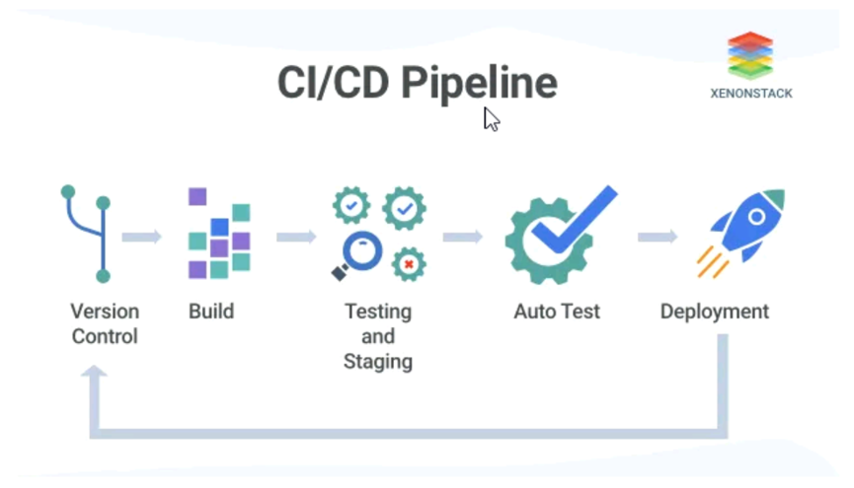

Slide 24
Stages/Phases of CICD Pipeline
Version Control Phase
In this phase of the CI/CD pipeline, the code written by the developers is committed through a version control software or systems such as git, apache subversion, and more.
It controls the commit history of the software code so that it can be changed if needed.
Build Phase
This phase is the first phase of this pipeline system. Developers build their code, and then they pass their code through the version control system or software. After this, the code returns to the build phase and gets compiled.

Slide 25
Unit Testing and Staging​
When software reaches this stage, various tests are conducted on the software. One of the main tests is the Unit test, in which the units of software are tested. ​
After successful testing, the staging phase begins. As the software has passed the tests to reach here, it is ready to be deployed into the staging process. ​
Here, the software code is deployed to the staging environment/server. The code can be viewed and finalized here before the final tests can be conducted on the software.​
Auto Testing Phase​
After passing to the staging environment, another set of automated tests are prepared for the software. Only if the software completes these tests and is proved to be deployable, then it is sent to the next phase/stage, which is the deployment phase.

Slide 26
Deployment Phase
As the auto testing procedure is completed, then it is deployed to production. However, if any error occurs during the testing phase or the deployment phase, the software is sent to the version control procedure by the development team and checked for errors.
If errors are found, then they need to be fixed. Other stages may be repeated if required.

Slide 27
CI/CD on AWS
AWS offers a number of services that can be used to implement CI/CD. These services include:
CodePipeline: CodePipeline is a service that can be used to automate the build, test, and deploy process.
CodeDeploy: CodeDeploy is a service that can be used to deploy code to Amazon EC2 instances, Amazon Elastic Beanstalk environments, and AWS Lambda functions.
CodeBuild: CodeBuild is a service that can be used to build code in the cloud.
CodeStar: CodeStar is a service that can be used to create a new development environment for a new project.

Slide 28
Create a CodePipeline pipeline
To create a CodePipeline pipeline, you need to create a new pipeline in the CodePipeline console. You need to provide a name for the pipeline, and you need to select the source, build, and deploy stages.
Add a source stage to the pipeline
The source stage is where you specify the location of your source code. You can use a variety of source repositories, such as GitHub, Bitbucket, and Amazon S3.
Add a build stage to the pipeline
The build stage is where you build your code. You can use a variety of build tools, such as AWS CodeBuild, Jenkins, and Travis CI.
Add a deploy stage to the pipeline
The deploy stage is where you deploy your code to a production environment. You can deploy your code to a variety of targets, such as Amazon EC2 instances, Amazon Elastic Beanstalk environments, and AWS Lambda functions.

Slide 29
Validate the pipeline
Once you have created the pipeline, you need to validate it to make sure that it is working correctly. You can validate the pipeline by clicking the "Validate" button in the CodePipeline console.
Deploy the pipeline
Once you have validated the pipeline, you can deploy it to make it available for use. You can deploy the pipeline by clicking the "Deploy" button in the CodePipeline console.
Once the pipeline is deployed, it will start automatically building, testing, and deploying your code. You can monitor the progress of the pipeline in the CodePipeline console has context menuComposeParagraph.

Slide 30
Benefits of CI/CD on AWS
There are a number of benefits to using CI/CD on AWS, including:
Scalability: AWS can scale to meet the needs of even the most demanding applications.
Reliability: AWS is a highly reliable platform with a proven track record.
Security: AWS offers a wide range of security features and services.
Cost-effectiveness: AWS is a cost-effective platform for hosting applications.

Slide 31
JENKINS​

Slide 32
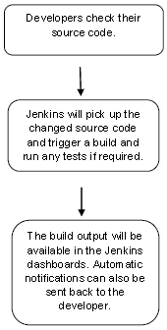
Jenkins is an open source automation server. It helps automate the parts of software development related to building, testing, and deploying, facilitating continuous integration and continuous delivery. It is a server-based system that runs in servlet containers such as Apache Tomcat.
Jenkins is a continuous integration/continuous delivery and deployment (CI/CD) automation software DevOps tool written in the Java programming language. It is used to implement CI/CD workflows, called pipelines.

Slide 33
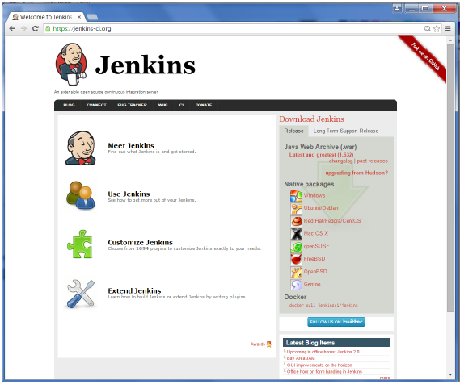
Download Jenkins
Starting Jenkins
Open the command prompt. From the command prompt, browse to the directory where the jenkins.war file is present. Run the following command
D:\>Java –jar Jenkins.war

Slide 34
After the command is run, various tasks will run, one of which is the extraction of the war file which is done by an embedded webserver called winstone.
D:\>Java –jar Jenkins.war
Once the processing is complete without major errors, the following line will come in the output of the command prompt.
INFO: Jenkins is fully up and running
Accessing Jenkins
Once Jenkins is up and running, one can access Jenkins from the link − http://localhost:8080

Slide 35
Advantages of Jenkins include:
It is an open-source tool with great community support.
It is easy to install.
It has 1000+ plugins to ease your work.
It is free of cost
It is built with Java and hence, it is portable to all the major platforms.

Slide 36
Docker

Slide 37
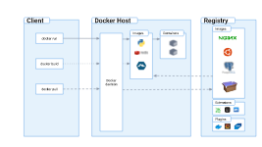
Overview
Docker is an open-source platform that allows you to automate the deployment and management of applications within containers.
Key features of Docker:
Containerization: Docker enables packaging applications and their dependencies into portable containers.
Lightweight: Containers are isolated and share the host OS kernel, making them lightweight and resource-efficient.
Portability: Docker containers can run on any machine with Docker installed, ensuring consistent behavior across environments.

Slide 38
CI/CD: Introduction and Benefits
Continuous Integration (CI) is the practice of merging code changes frequently into a central repository and automating build and test processes. Continuous Deployment (CD) is the practice of automatically deploying code changes to production environments.
Benefits of CI/CD:
Faster time to market: Frequent integration and automated testing speed up the software development lifecycle.
Improved quality: Automated testing and continuous feedback ensure higher code quality.
Reduced risk: Automated deployment reduces the chances of human error and enables rollbacks in case of issues.

Slide 39
CI/CD Pipeline Components
Source code repository: Developers use a version control system (e.g., Git) to manage and collaborate on the codebase.
Build and test automation tools: Tools like Jenkins, Travis CI, or GitLab CI/CD automate building, testing, and code quality checks.
Artifact repository: Docker Registry or a private registry stores Docker images built during the CI/CD pipeline.
Deployment and orchestration tools: Tools like Kubernetes or Docker Swarm help deploy and manage containers in production environments.

Slide 40
Docker in CI/CD
Benefits of using Docker in CI/CD:
Consistent environments: Docker containers provide a consistent runtime environment across development, testing, and production stages.
Reproducibility: Docker images are version-controlled and can be easily shared across teams, ensuring consistent deployments.
Scalability: Docker containers allow horizontal scaling, making it easier to handle increased workloads.
Isolation: Each container is isolated, preventing dependency conflicts and ensuring application stability.

Slide 41
Building Docker Images in CI/CD
Dockerfile: A Dockerfile is a text file that contains instructions to build a Docker image, specifying the base image, dependencies, and application configuration.
Automated builds: CI/CD tools can automate the image building process by listening to code changes, triggering builds, and pushing the images to a Docker Registry.

Slide 42
Testing with Docker Containers
Benefits of testing with Docker containers:
Environment consistency: Testing in containers ensures that the application runs in the same environment as production.
Isolation: Each test can run in an isolated container, preventing interference from other tests.
Reproducibility: Docker images can be versioned, making it easy to reproduce test environments.

Slide 43
Deploying Docker Containers
Container orchestration: Tools like Kubernetes simplify the deployment and management of containers at scale.
Benefits of deploying Docker containers:
Scalability: Containers can be easily scaled up or down based on demand.
Rollbacks: With container deployments, it's possible to roll back to previous versions quickly in case of issues.
Blue-green deployments: Docker enables running multiple versions of the application simultaneously, allowing seamless switching between them

